Slide 1
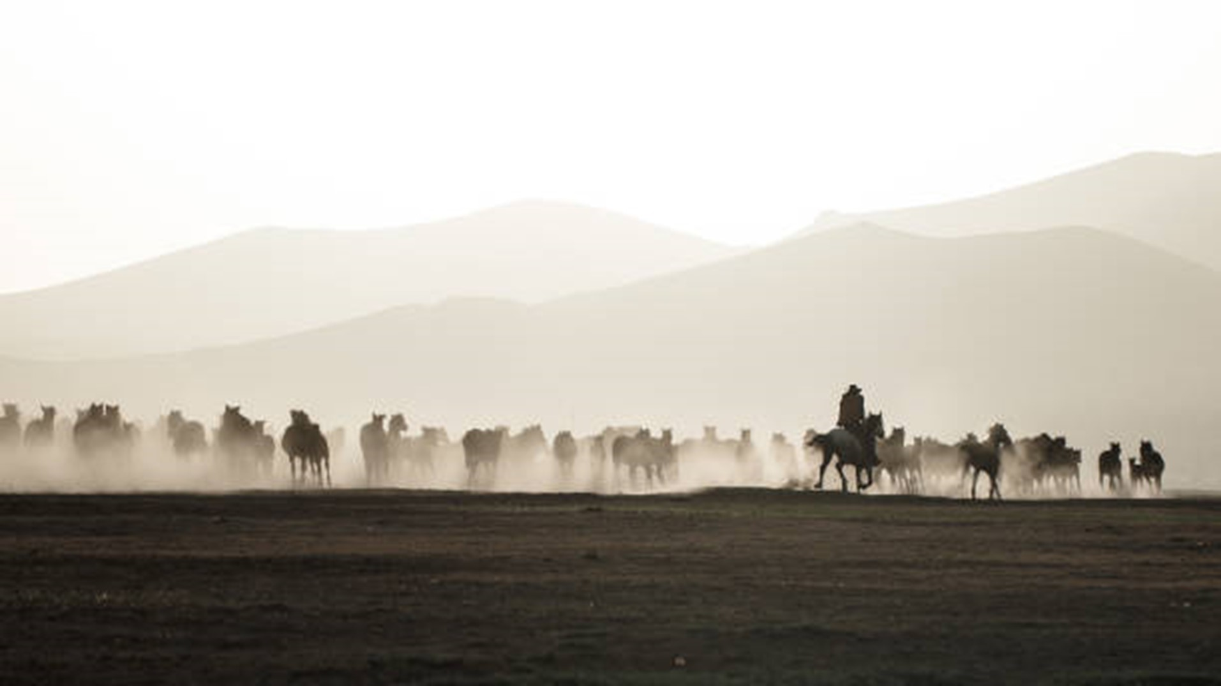

B R O K E N A R R O W
wranglers
ALL FOR YOUR GLORY JESUS
Notes:
GALATIANS 1:12
MATTHEW 19:29 PSALM 34:4
EXPERIENCE FREEDOM IN TRUE RELATIONSHIP

Slide 2
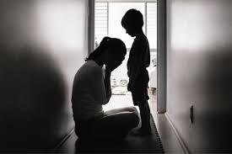
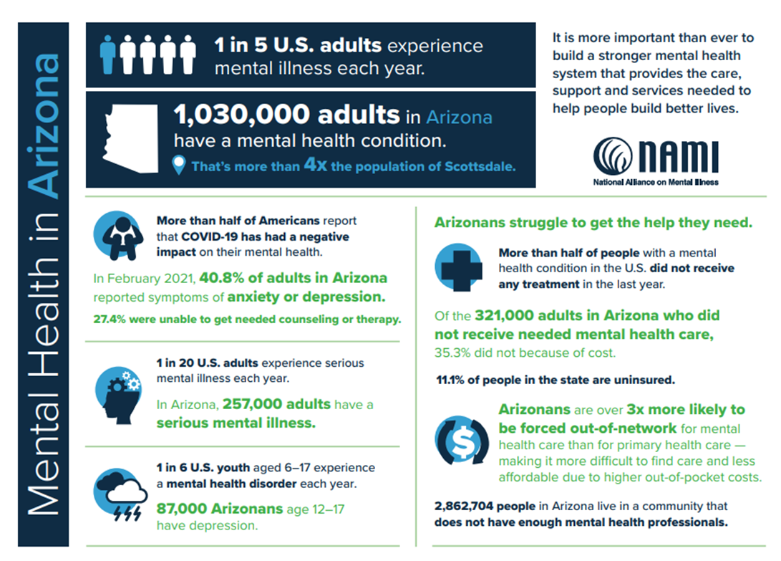
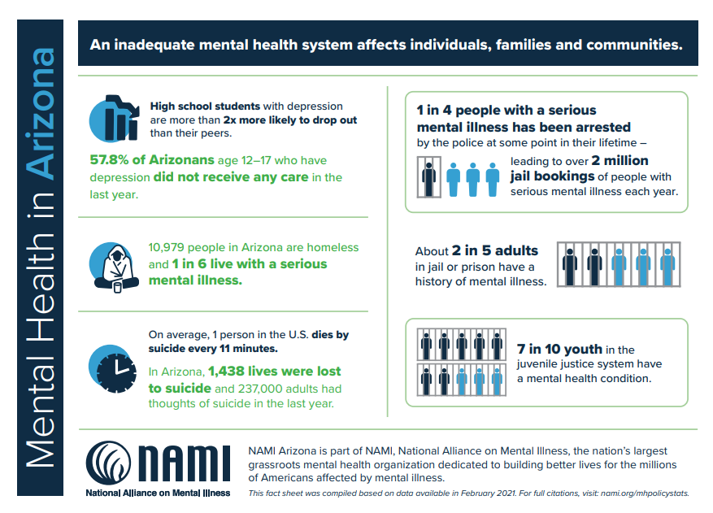
Mental health pandemic
1 in 5 U.S. adults experienced mental illness each year
1 in 6 U.S. youth aged 6-17 experience a mental health disorder each year
More than half did not receive any treatment (cost, out of network, uninsured, not enough health professionals)
Data provided by NAMI
Notes:
I AM NOT ALONE IN THIS STRUGGLE

Slide 3

ELIMINATE THE PROBLEM
LOOKING FOR A COMMON THREAD…
GO FORWARD BY GOING BACK…
DON’T SAY EVERYTHING
SEAR EVERYTHING IN…
GET TO THE ROOTS
LACK OF COMMUNITY OF SUPPORT
SCARCITY MINDSET
OVEREXPOSURE TO STRESS
LOSS OF UNITY IN PURPOSE
REBUILD WHAT WE HAVE LOST
MENTAL HEALTH PANDEMIC
Notes:
What if anxiety was simply a natural response to wake up. A resistance to the systems of this world. And the more we ignore it, the worse it gets
THEORY OF CONSTRAINTS –
Mental health issues are rooted in lack of freedom, scarcity mindset, overexposure to stress, and lack of unity in purpose. If people feel that they are able to find their talents and gifts, use them in the service of others and they have purpose in their life, they heal.
So much of our current health issues today are tied to mental / emotional health and stress impacting the body and creating illness.
If people have a community where they are honest, free from judgment, and know that people have their back…stress levels decrease.
If people know they have an abundance of resource as opposed to scarcity and lack (including emotional and spiritual stability / consistency), stress levels decrease.

Slide 4
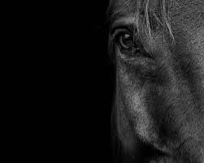
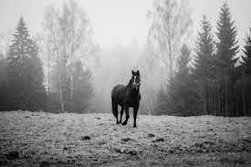
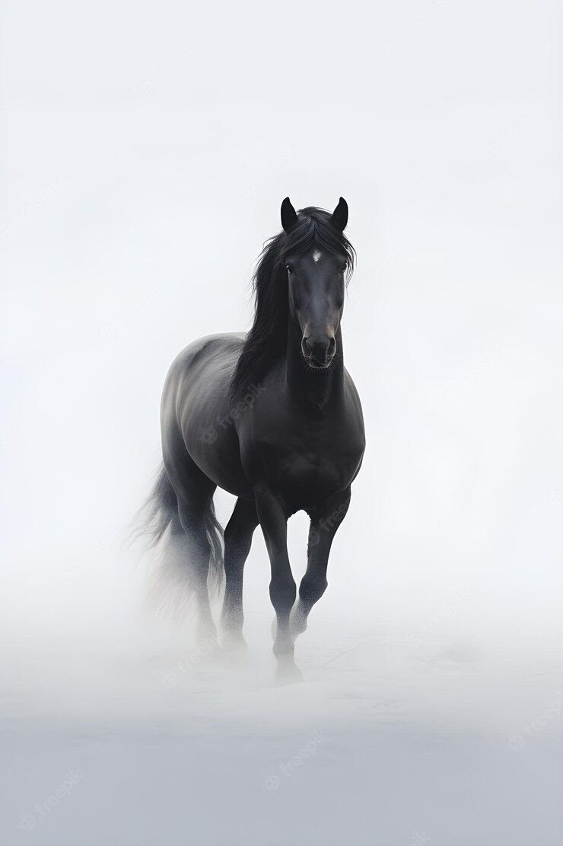
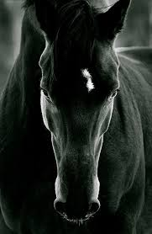
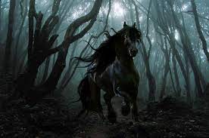
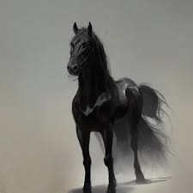
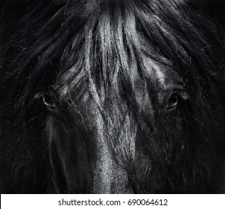
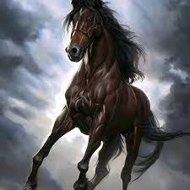
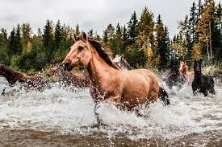
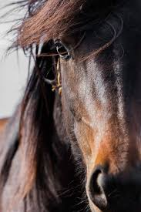
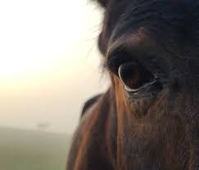
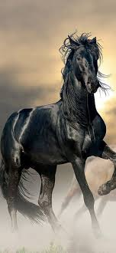
Behold, he is coming with the clouds, and every eye will see him…
Notes:
Behold, he is coming with the clouds, and every eye will see him…
IN 2019 – EVERYTHING CHANGED….7 DAY OUTPATIENT….CREATE THE ENVIRONMENT….
ATTENDED AN EQUINE THERAPY PROGRAM CALLED RITE OF PASSAGE
and he that sat upon him was called Faithful and True…
https://www.freepik.com/premium-photo/black-horse-with-white-eyes-runs-through-foggy-field_44019559.htm
https://www.google.com/search?q=dark+horse%2C+fog%2C+eye&tbm=isch&ved=2ahUKEwiurLeZ7N__AhXwAUQIHUvDCDIQ2-cCegQIABAA&oq=dark+horse%2C+fog%2C+eye&gs_lcp=CgNpbWcQAzoECCMQJzoJCAAQGBCABBAKOgcIABAYEIAEOgUIABCABDoGCAAQCBAeOgQIABADOggIABCABBCxAzoGCAAQBRAeUK8QWL8hYI8jaABwAHgAgAG7BYgB7QySAQc5LjMuNS0xmAEAoAEBqgELZ3dzLXdpei1pbWfAAQE&sclient=img&ei=CfKYZO6DEPCDkPIPy4ajkAM&bih=731&biw=1536&client=firefox-b-1-d&hl=en
https://www.shutterstock.com/search/dark-horse
https://www.shutterstock.com/search/similar/1332168638
https://www.shutterstock.com/image-photo/portrait-beautiful-black-horse-on-background-1424162639

Slide 5
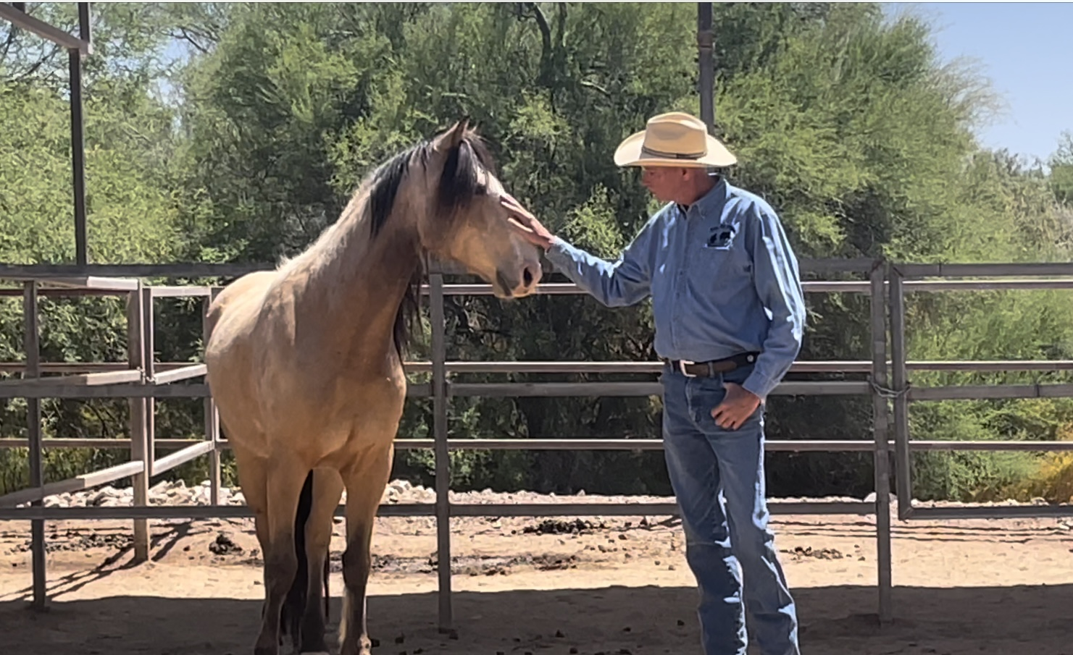
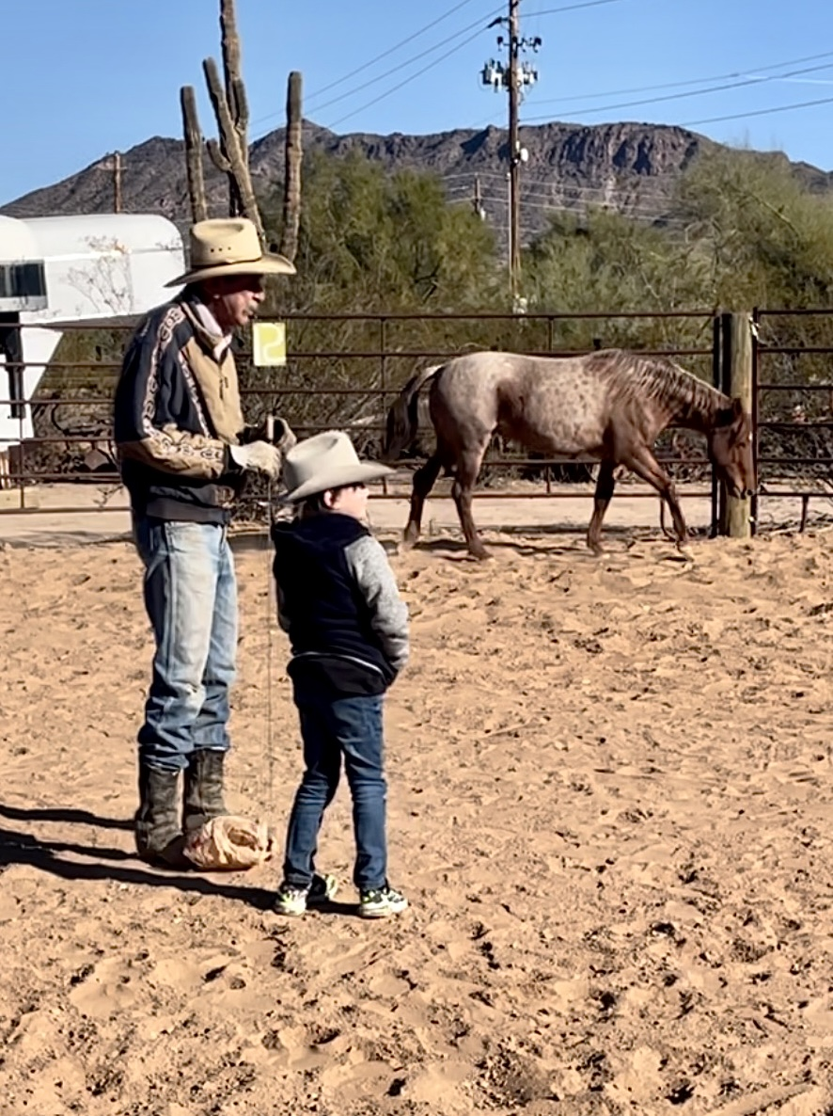
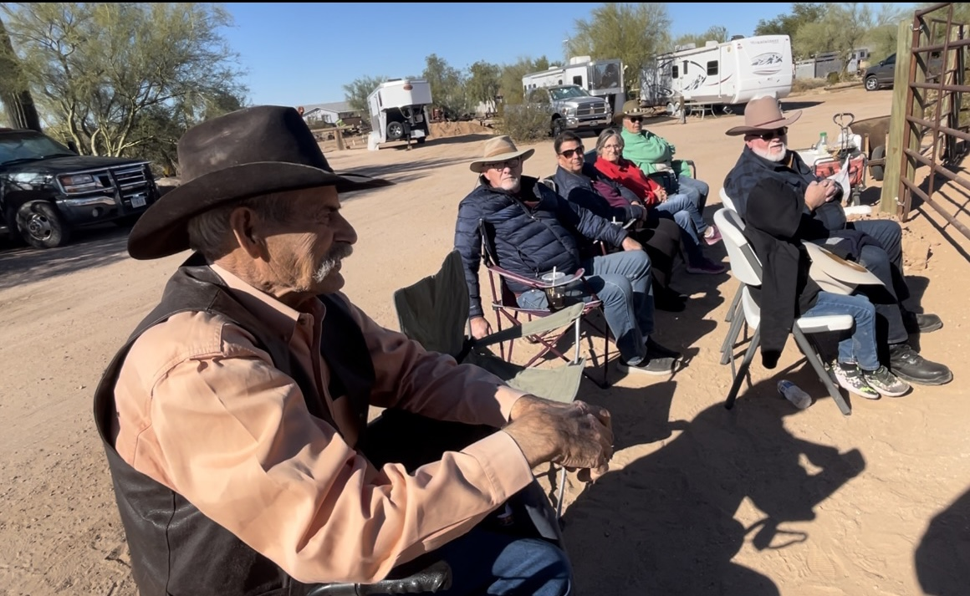
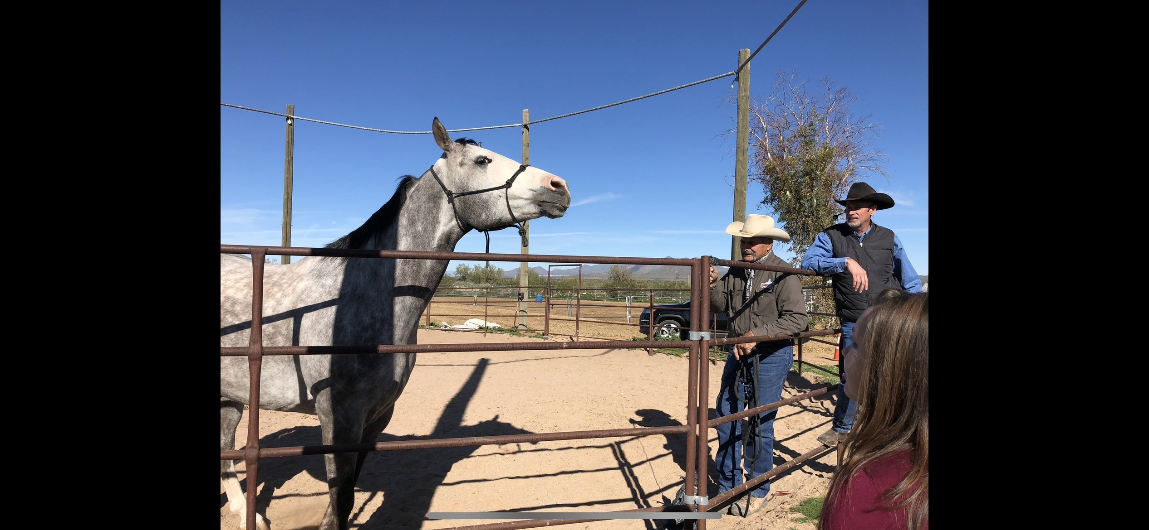
THE GATE
The horse
Honesty
Body
Spirit
Communication
Relationship
Trust
Face and walk through fear
Enter through the gate
John 10:7, Ephesians 4
Notes:
2019 – Empathy based equine therapy program called Rite of Passage.
Most awakening experience
Communication, relationship, trust, hope – then something happened.
Same place as therapy session
Share our darkness….horse leads….shows us this as they are honest, face fears….walk right through it
Experienced leadership like I had never seen
Modeled our relationship with God
Using natural horsemanship and wild or high anxiety horses
Survival mode….much the same as we are when we are experiencing mental / nervous system issues.
Put a face to the story
Problem statement followed
Saw it
Cowboys needed exposture
Heros needed a community to serve
Property and platform
Resources available…
7 key customers….

Slide 6

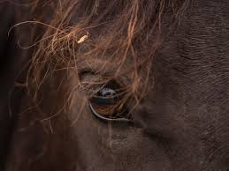
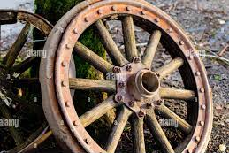

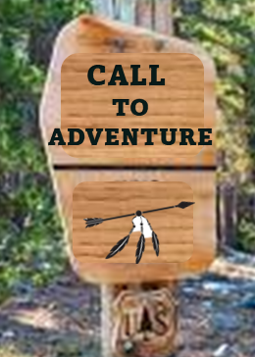
Broken arrow wranglers ecosystem
King’s network funding
Directory of local experiences
Collaboration platform
Integrated programs
Scalable and Customizable
Co-Op of local resources
United in Purpose – common story
Shared Values - Freedom in Community
Community Co-Op
(HUB)
Directory
Services
Events
Experiences
The gate
Horse experiences
Our kings ranch
Inner kingdom life
World class natural horsemanship
Transformational therapy programs
Scalable to reach large groups
Leveraging the collective values, talents, and resources through a common story and a victory claimed
Business Services Team
Notes:
Red mountains
https://www.google.com/search?client=firefox-b-1-d&sxsrf=APwXEdfbNa_SYOZWg8nQfyjcQb8GbkmEUw:1687793608441&q=red+mountains,+dark&tbm=isch&sa=X&ved=2ahUKEwiexvCToeH_AhV5L0QIHcFKCzoQ0pQJegQIDhAB&biw=1536&bih=731&dpr=1.25

Slide 7

Value Stream Modeling (See original architecture design)
7 Different Value Streams
Gate stream (commissions)
Membership
BCS Services
Fundraising
Commission (Experiences and Services)
Outfitter (Counselor)
Horse rehabilitation
See Cash Flow Model for the above
Kailie Plan
Core Customer Groups
Heros
Horses
Gate guides
Outfitters /path mappers
Experience leaders
Business Services team

Slide 8
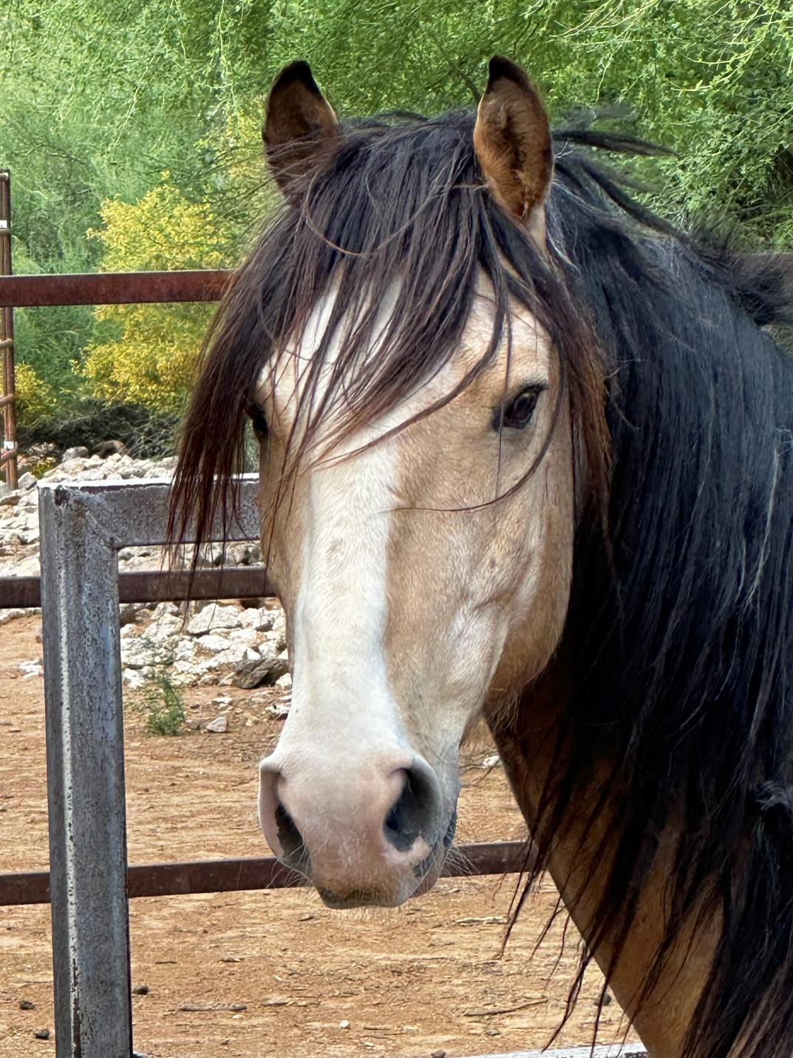
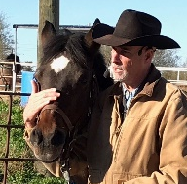
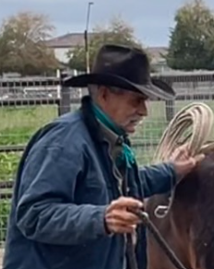
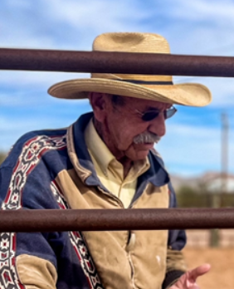

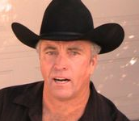
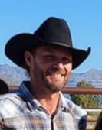
OUR TEAMS
GATE TEAM
UNIQUE HORSES THAT LEAD IN HONESTY
Rob Boyle – Rite of Passage Therapy
Charlie Hill – Horse Camps for Christ
Mike Buchanan – Self within Self
Kaleigh Rogers – Shine His Light
Scott Tyler – Ranch Operations
Sean McNabb – Executive Director & Business Systems
Business services team
Ken Lowell – Creative Director
Samantha – Social Media Marketing and Graphic Design
Cummings and Company – Accounting
Ryan Wilson – IT Architecture
Rick – Website and systems development
Legal team
Director of Development & Event planning - Kailie
Project management: Way Forth Collective
Balance Consulting Services, LLC – Business consulting
Business / Ministry Partners: See directory, Stay Forth, etc
Web Support – Kiera
Voice – John Griffin, Event / DJ – Leo
Outlaw gear and apparel – Chris Cheney and team
Notes:
See team bios and detail here….
Experience freedom through relationship

Slide 9
Board of Directors
Ken Key – God’s Glory
Ron Gelok – King’s Network
Kerry Jackson – Effective & Accountable
Ryan Wilson – Technology Experience
Scott Tyler – Ranch Operations / Prayer
Executive Director – Sean McNabb

Slide 10
Management Operations System
Financial
Meetings
Board meetings
Weekly
Monthly
Events
Guidelines and Governance
Pending
Daily, weekly, monthly, quarterly
Notes:
Financial structure
100K?
10% to give back
10% to scholarships
10% to operations investment payback
10% to Marketing
10% to Community building
5% commission?
33% distribution in salary?
12% to ??

Slide 11

Call to Adventure Join the Broken Arrow Story - Ride for the Brand
3 ways to enter in
Attend an event and experience authentic relationship: azbrokenarrow.com directory
Give a one-time gift: https://www.azbrokenarrow.com/donate/
Give a recurring monthly gift: https://www.azbrokenarrow.com/donate/
Spread the word: Share the story through
https://www.instagram.com/azbrokenarrow/
https://www.facebook.com/azbrokenarrow
Join as a business partner – contact sean@azbrokenarrow.com
Notes:
See customer types

Slide 12
Supplemental slides

Slide 13
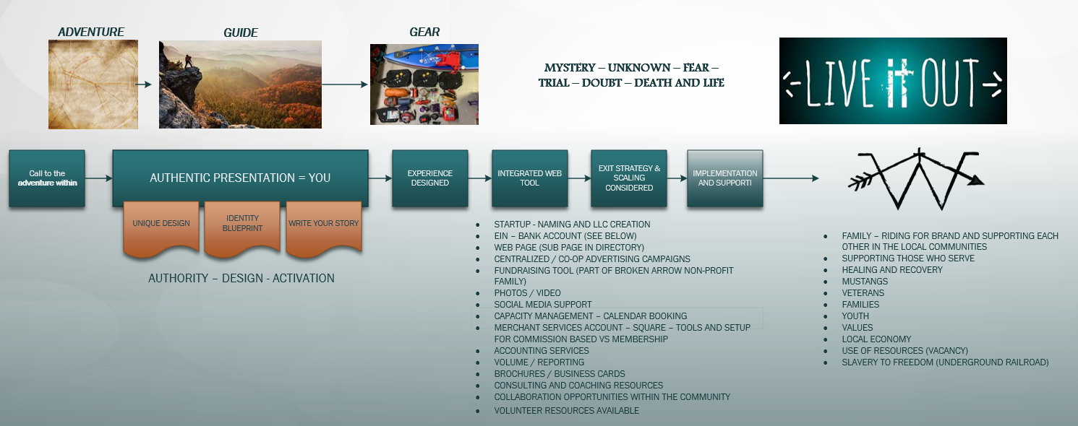
BALANCE CONSULTING SERVICES

Slide 14
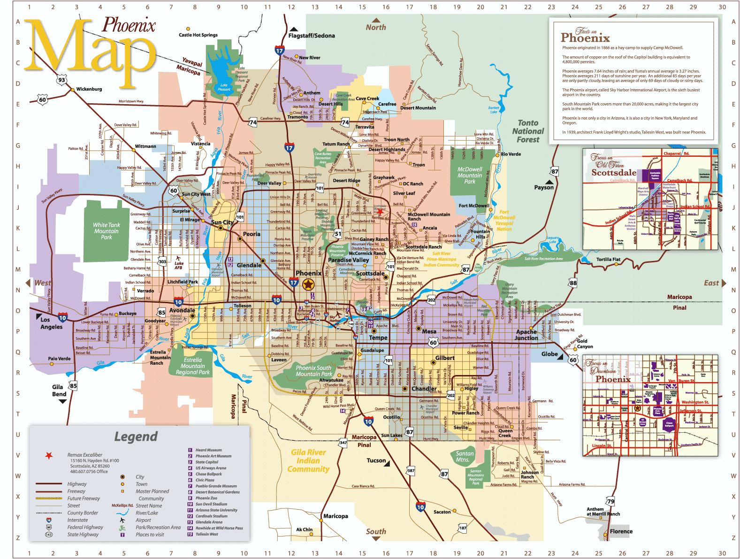
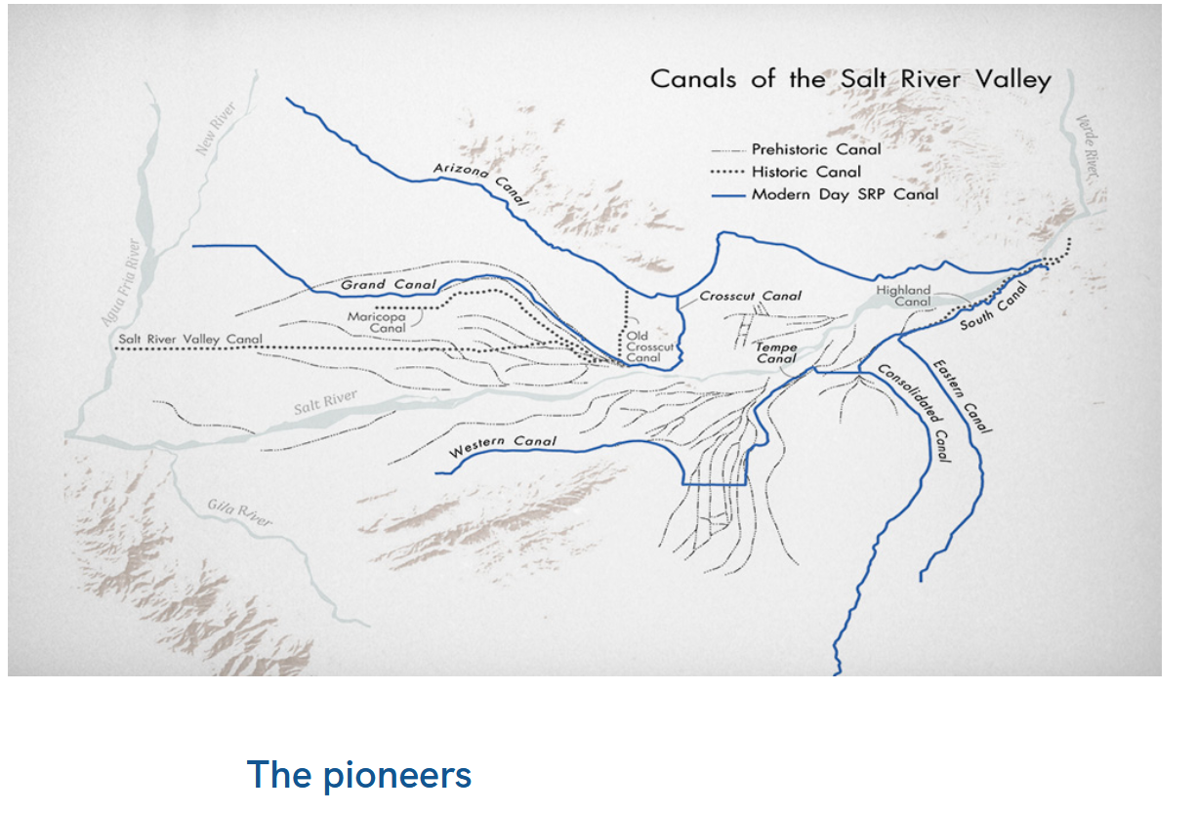
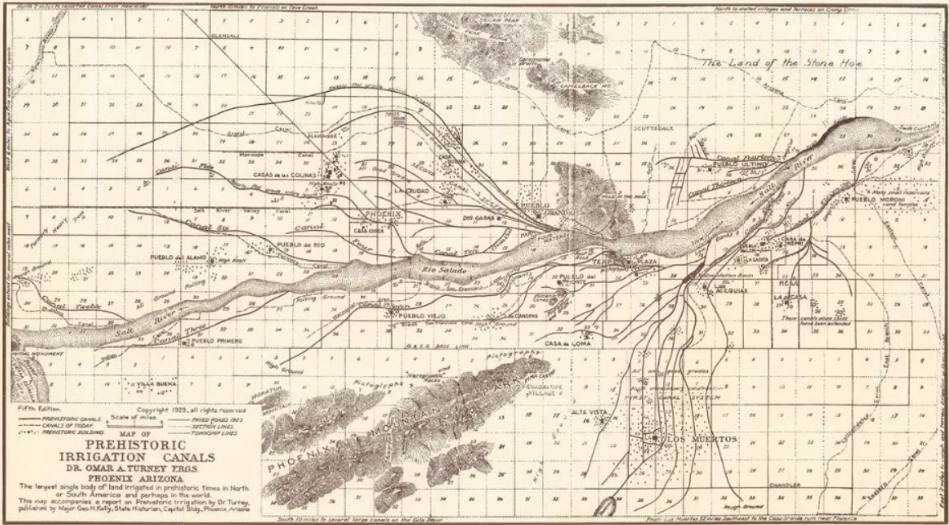
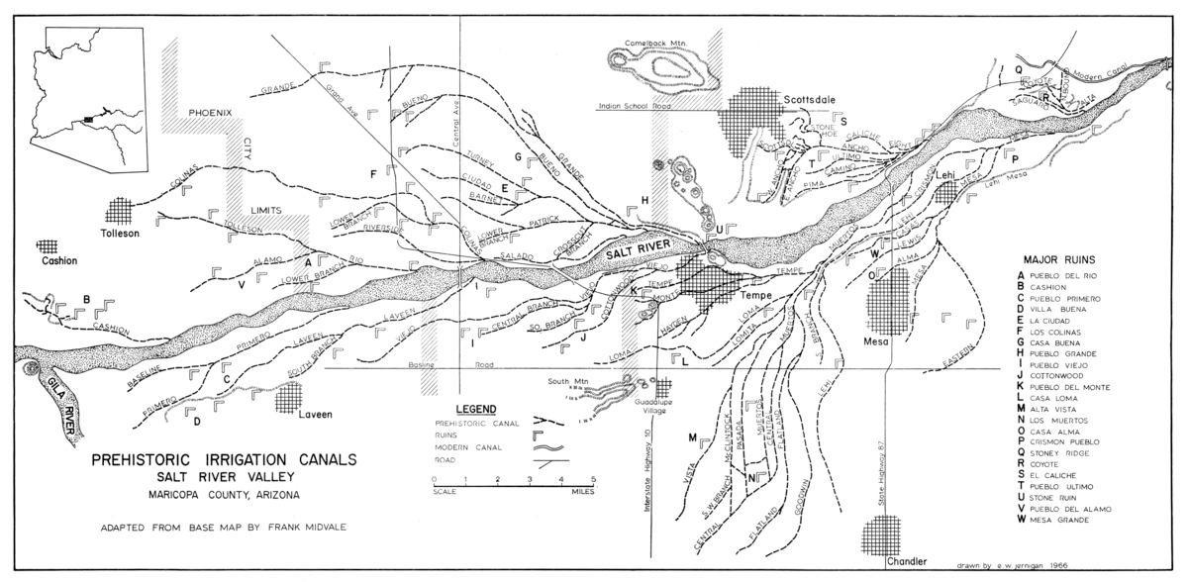



X
OUTPOST
OUTPOST
X
X
X
X
X
OUTPOST
X
OUTPOST
RANCHES - PROPERTIES - OUTPOSTS
OUTPOST
X
OUTPOST
Notes:
https://www.srpnet.com/about/history/canal-history

Slide 15
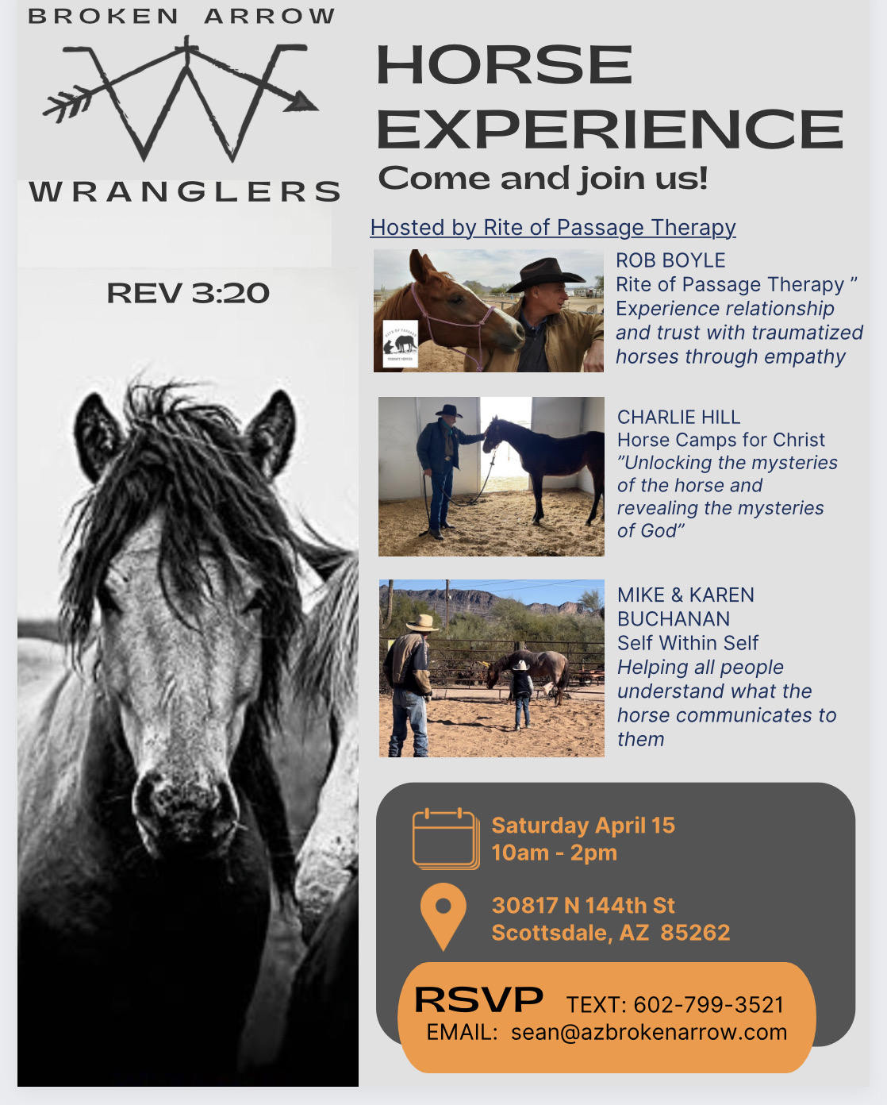

Slide 16

Schedule and Goals -- roots and fruit
Plan
GOALS
CREATE FOUNDATIONAL SYSTEMS
LOAD UP DIRECTORY
OBTAIN FINANCIAL SUPPORT FOR “GAP”
LAUNCH MARKETING CAMPAIGN
SECURE GRANTS
SCALABLE ECOSYSTEM
CREATE ENVIRONMENT TO SUPPORT THE COMMUNITY
SHARE THE STORY
AD GRANTS, SOCIAL MEDIA
SECURE FUNDING

Slide 17
Where we are going…
Gates are open (events and experiences)
Foundation is solid (Kingdom is here)
Resources are in abundance (common story)
Transforms the economy (see hatchery mindset story…)

Slide 18

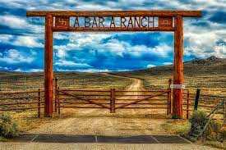
IMPLEMENTATION
GATE
RANCH
OUTFITTERS
HANDS
VISION
MODEL AND PLATFORM BUILT
100 PARTNERS – RIDE FOR THE BRAND
FUNDS THE AD GRANTS
COMMUNITY SUPPORT CREATED – VACANT RESOURCES ENGAGED
OBTAIN THE FUNDING TO GIVE IT ALL AWAY $350k
CREATE THE ECONOMY
SERVE 1000 PEOPLE THIS SEASON

Slide 19
Business Model and Cash flow projection
Initial
Start up
Close the gap
State funded
Create economy
Budget
Operations
SUSTAINABLE
ECOSYSTEM

Slide 20
SOLUTION DELIVERY
PROBLEM
SOLUTION
LIMITED ACCESS TO CARE
NOT AFFORDABLE
OUT OF NETWORK
ANXIETY AND DEPRESSION
SUICIDE
IMPRISONMENT
HEALTH PROFESSIONALS NOT ABLE TO SUSTAIN THE LOAD
LOCAL PROGRAMS
SCHOLARSHIPS, STATE, DONATIONS AND MEMBER FUNDED
CHANGING CULTURE OF HEALING MENTAL HEALTH
REDUCTION IN COSTS
FREEDOM
CAPACITY BASED MODEL

Slide 21
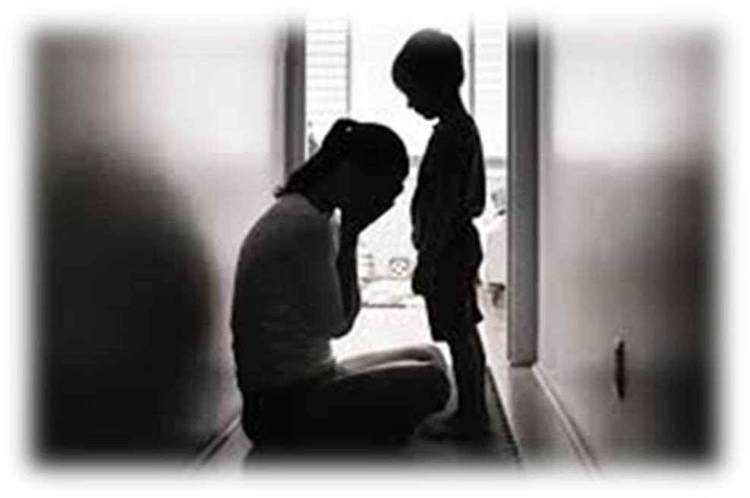
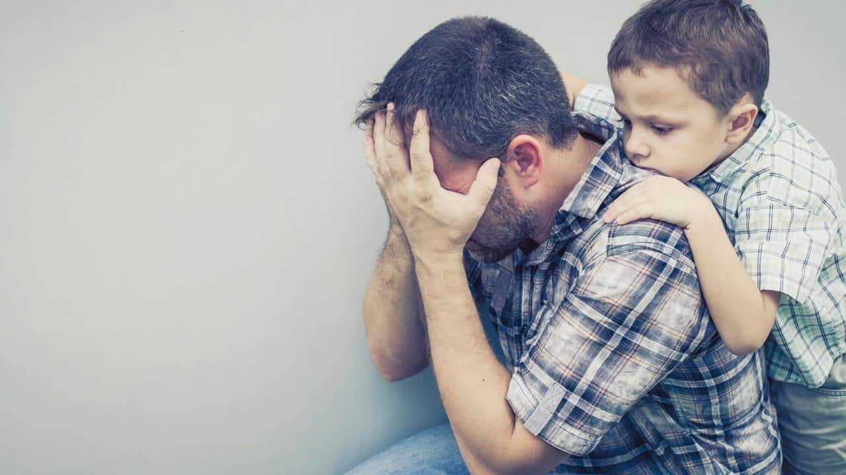
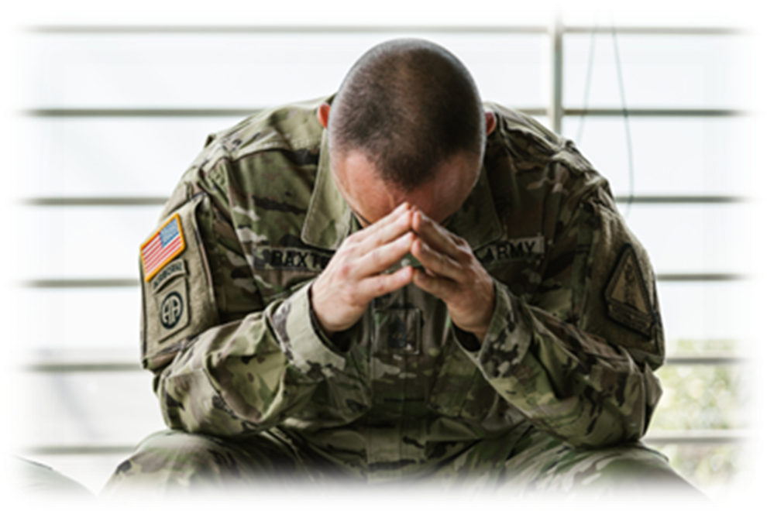
Source: National Alliance on Mental Illness (NAMI)
1 in 5 in the U.S. experiences mental illness
40.8% report symptoms of anxiety or depression
More than half do not receive treatment
(35.3% did not because of cost)
1 person in the U.S. commits suicide
every 11 minutes
Notes:
ArizonaStateFactSheet_NAMI.pdf

Slide 22
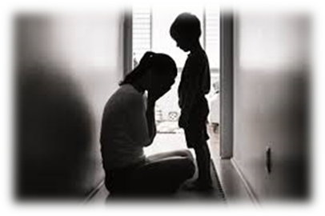
1 in 5 in the U.S. experiences mental illness

Slide 23
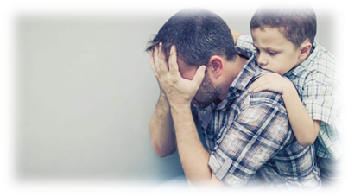
40.8% report symptoms of anxiety or depression

Slide 24
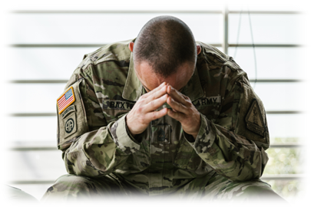
More than half do not receive treatment

Slide 25
1 person in the U.S. commits suicide every 11 minutes

Slide 26
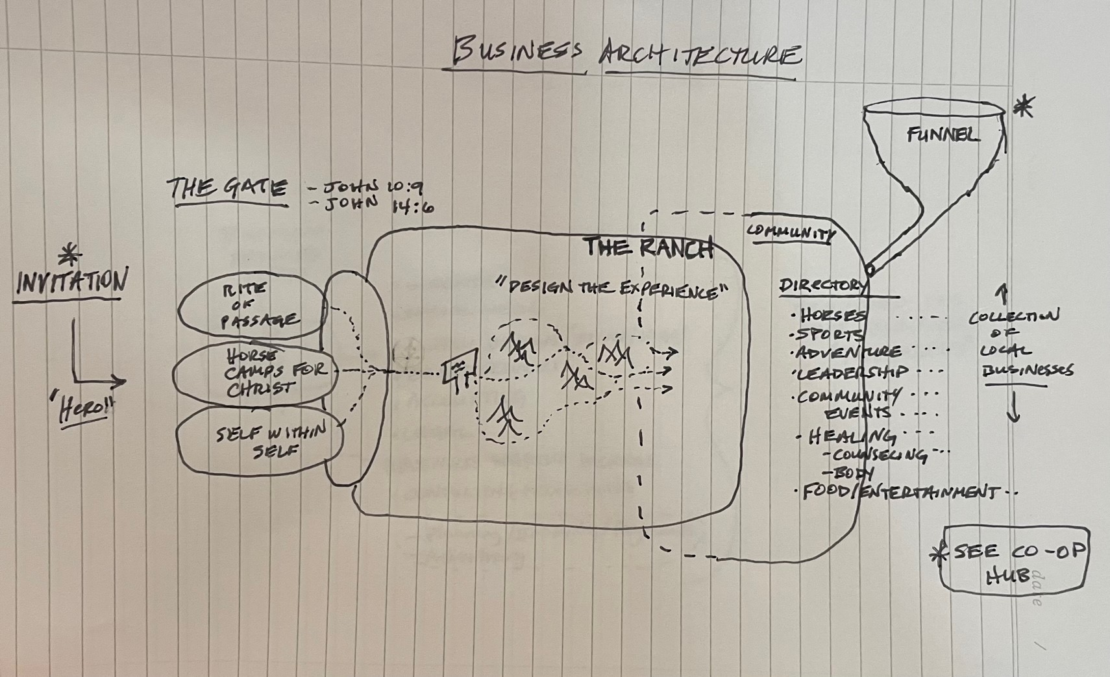
$$ Pricing
Hero Journey Map
Experiences
12 deep

Slide 27
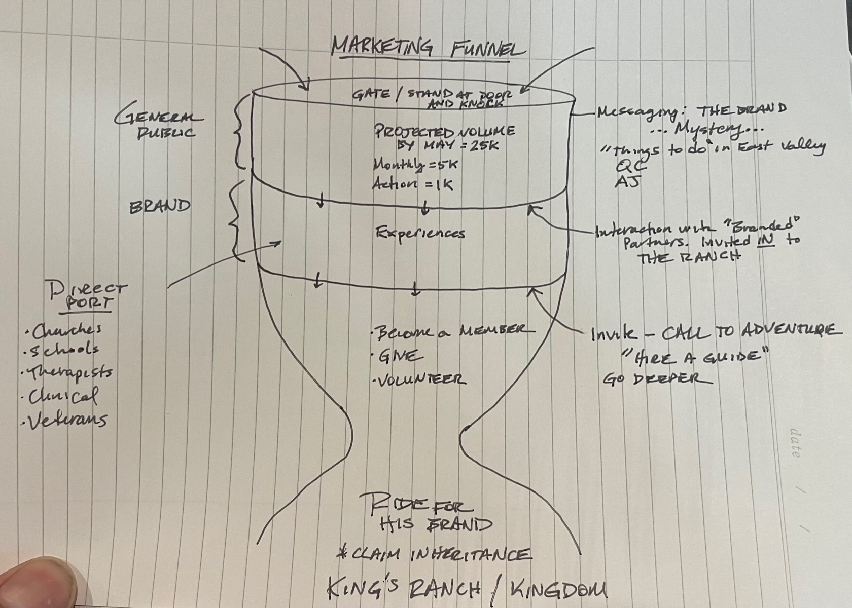
$$ Pricing
(Marketing HUB Membership)

Slide 28
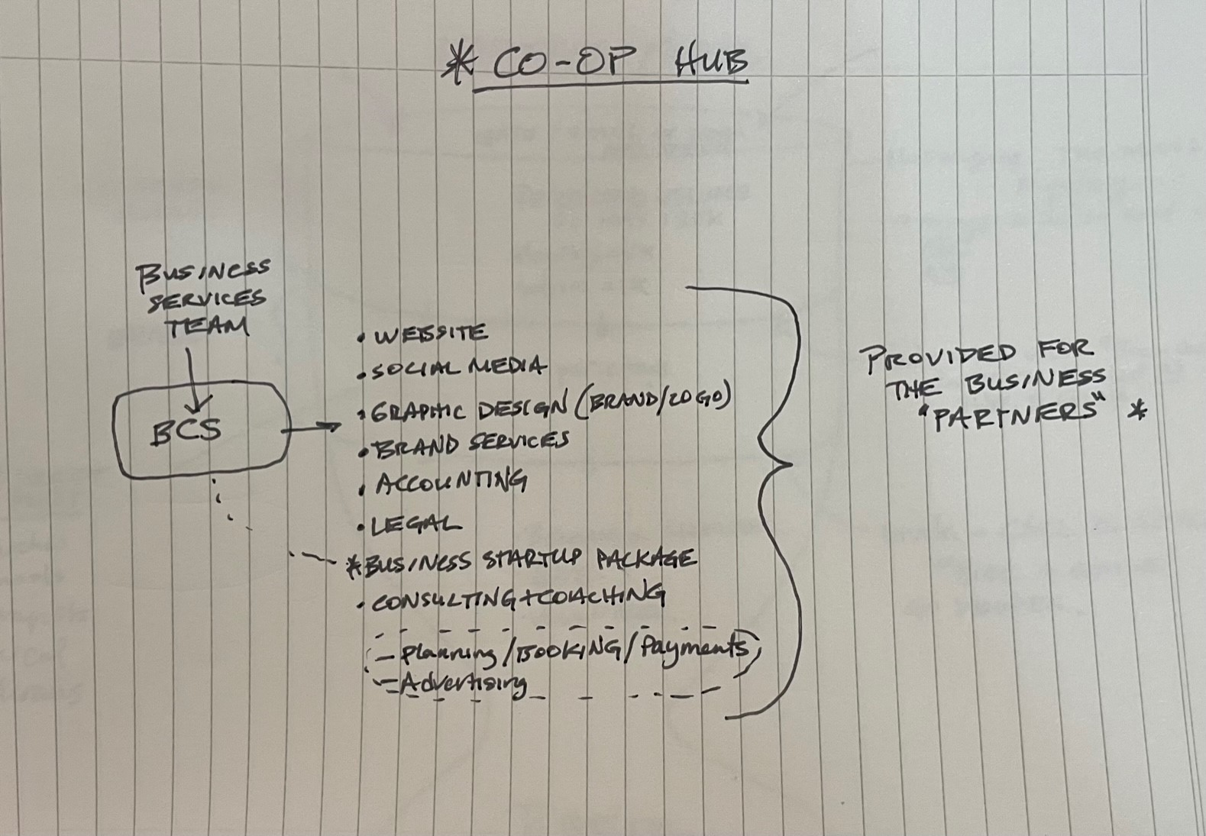
$$ Pricing

Slide 29
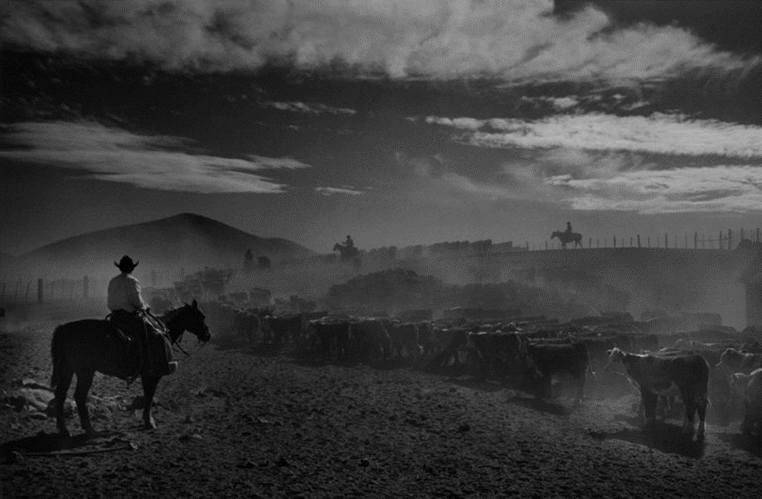

O u t p o s t

Slide 30
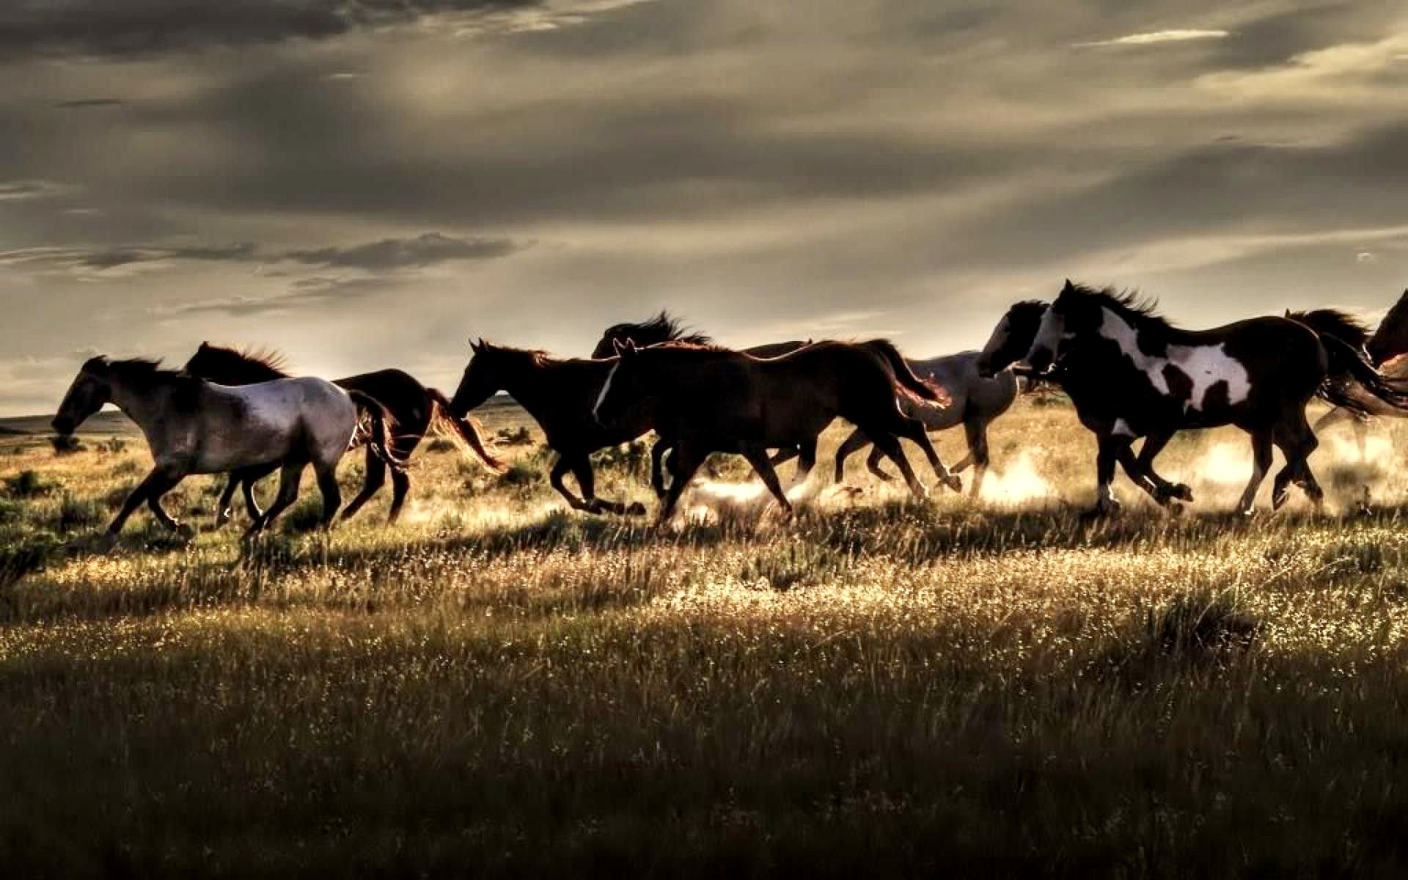
M u s t a n g

Slide 31
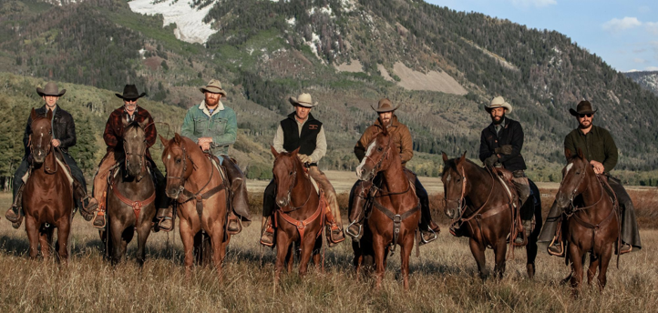
W R A N G L E R

Slide 32
